Slide 1

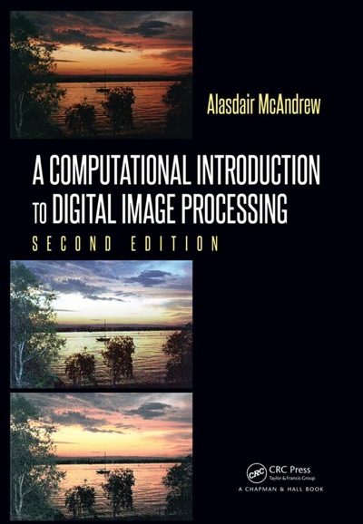
Chapter 7
The Fourier Transform

Slide 2

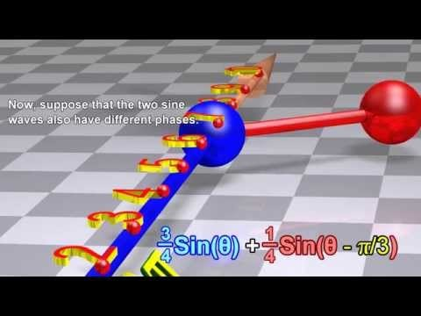
Fourier Transform Video

Slide 3

Fourier Transform Video

Slide 4
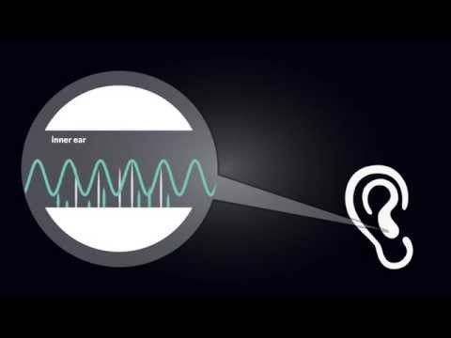
Fourier Transform Video

Slide 5
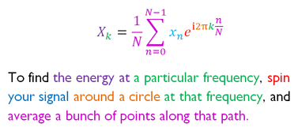
Fourier Transform

Slide 6
Introduction
Why Fourier Transforms?
Efficiency
Alternative to spatial filtering
Perform low pass and high pass filtering with great degree of precision

Slide 7

Background
Observation:
periodic function may be written as the sum of sines and cosines of varying amplitudes and frequencies.
The more terms of the series we take, the closer the sum will approach the original function.

Slide 8
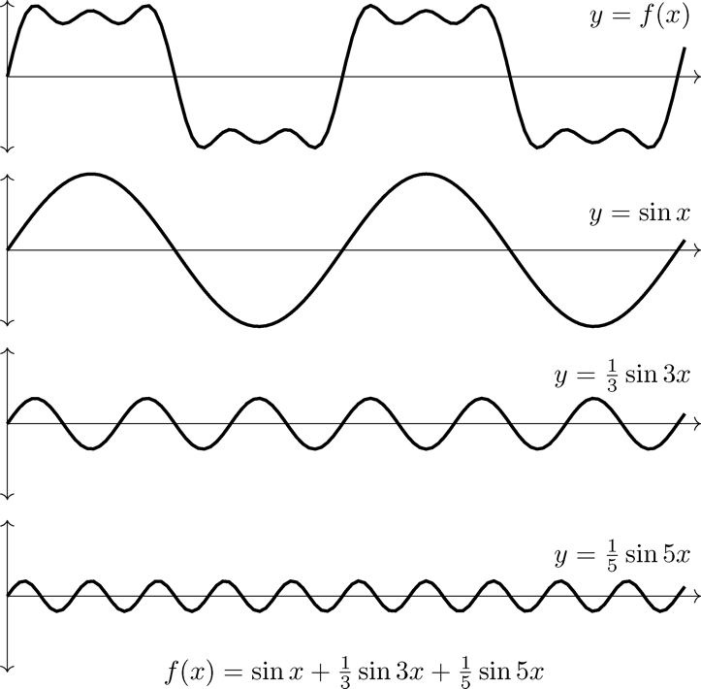
Background
Figure 7.1: A function and its trigonometric decomposition

Slide 9
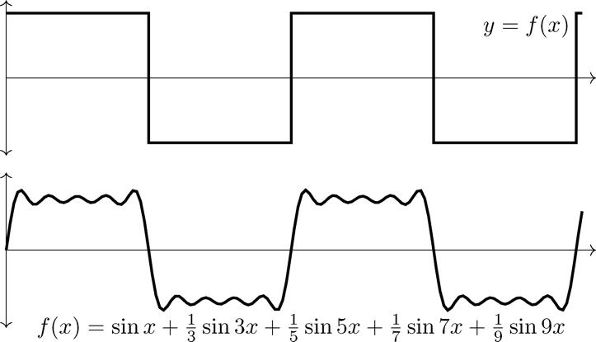
Background
A square wave and its trigonometric approximation

Slide 10

Background
f(x) and F(ω) form a Fourier transform pair.

Slide 11
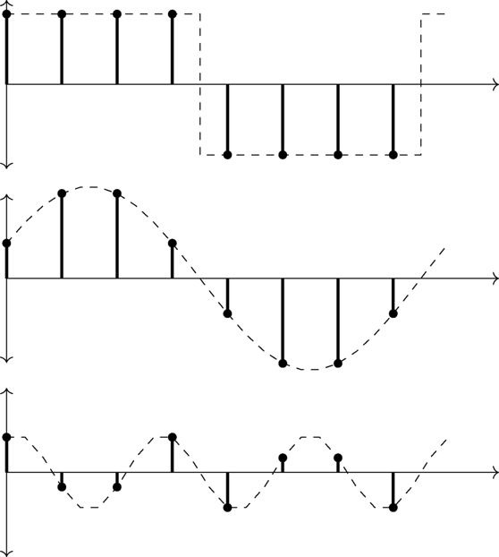
One-Dimensional DFT
Discrete function
only have to obtain finite number of values
only need finite number of functions
Figure 7.3: Expressing a discrete function as the sum of sines

Slide 12
One-Dimensional DFT
Definition of Discrete Fourier Transform
Suppose
We define its discrete Fourier Transform to be
where

Slide 13
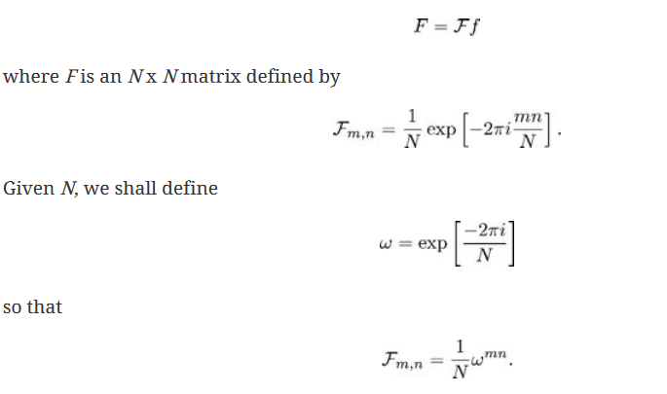
One-Dimensional DFT
This definition can be expressed as a matrix multiplication:

Slide 14
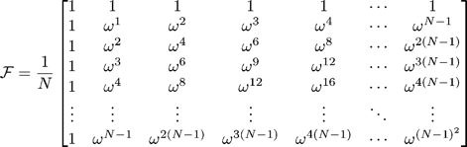
One-Dimensional DFT
Then we can write

Slide 15

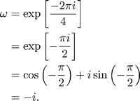
One-Dimensional DFT
Example
Suppose f = [1, 2, 3, 4] so that N = 4

Slide 16


One-Dimensional DFT
f = [1, 2, 3, 4] so that N = 4

Slide 17
Inverse DFT
Formula for inverse DFT
Two differences
No scaling factor 1/N
Sign inside exponential f(x) is positive

Slide 18

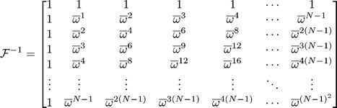
Inverse DFT
As with the forward transform, we can express this as a matrix product:

Slide 19
One-Dimensional DFT
Matlab or Octave
Functions
fft
ifft
Python
Libraries
scipy
numpy

Slide 20
Properties of One-Dimensional DFT
Linearity
Direct consequence of definition as matrix product
Shifting
Change sign of every second element
Conjugate symmetry
Convolution
A.k.a. circular convolution
Defined in terms of polynomial products
Fast Fourier Transform
Vastly reduces the time needed to compute a DFT

Slide 21
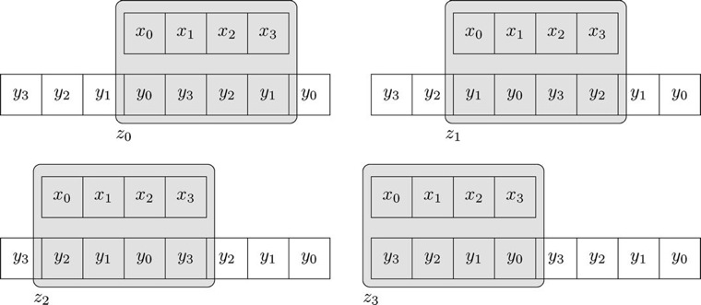
Convolution Example
Figure 7.4: Visualizing circular convolution

Slide 22
Convolution Example
Table 7.1 Comparison of FFT and direct arithmetic
2^{n} | Direct arithmetic | FFT | Increase in speed
4 | 16 | 8 | 2.0
8 | 84 | 24 | 2.67
16 | 256 | 64 | 4.0
32 | 1024 | 160 | 6.4
64 | 4096 | 384 | 10.67
128 | 16384 | 896 | 18.3
256 | 65536 | 2048 | 32.0
512 | 262144 | 4608 | 56.9
1024 | 1048576 | 10240 | 102.4

Slide 23
Two-Dimensional DFT
Input: matrix
Output: second matrix of same size
F is the Fourier Transform of f and is written:
Definition

Slide 24
Two-Dimensional DFT
Properties
Similarity
DFT as spatial filter
Separability
Linearity
Convolution theorem
DC coefficient
Shifting
Conjugate symmetry
Displaying transforms

Slide 25
Two-Dimensional DFT: Similarity
Forward and inverse transforms very similar
Exceptions:
scale factor 1/MN in inverse transform,
negative sign in exponent of forward transform
same algorithm, only very slightly adjusted, can be used for both the forward and inverse transforms.

Slide 26
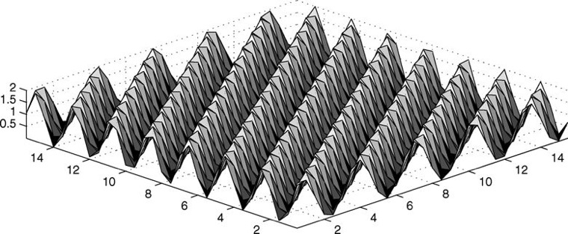
Two-Dimensional DFT: Spatial Filter
What is does:
multiplies all elements under a mask with fixed values, and adds them all up.
Can consider DFT as linear spatial filter
Figure 7.5: A “corrugation” function

Slide 27
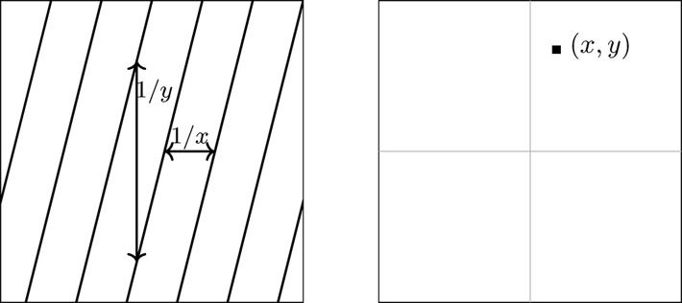
Two-Dimensional DFT: Spatial Filter
Figure 7.6: Where each corrugation is positioned on the spectrum

Slide 28
Two-Dimensional DFT: Separability
Notice:
Fourier Transform “filter elements” can be expressed as products
Why is that important?
break down our formula into simpler formulas

Slide 29
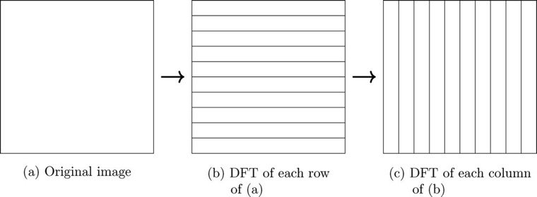
Two-Dimensional DFT: Separability
Obtaining 2-D DFT
Calculate DFT of rows
Calculate DFT of columns of above result
Figure 7.7: Calculating a 2D DFT

Slide 30

Two-Dimensional DFT: Linearity
DFT of a sum is equal to the sum of the individual DFTs
Why is this useful?
Dealing with image degradation such as noise
Noise appears on a DFT in such a way as to make it easy to remove

Slide 31
Two-Dimensional DFT: Convolution Theorem
The convolution theorem: One of the most powerful advantages of using the DFT.
Suppose we wish to convolve an image M with a spatial filter S. Our method has been place S over each pixel of M in turn, calculate the product of all corresponding gray values of M and elements of S, and add the results. The result is called the digital convolution of M and S, and is denoted:
M * S
This method of convolution can be very slow, especially if S is large.

Slide 32
Two-Dimensional DFT: Convolution Theorem
Convolution Theorem states that M * S can be obtained by:
Pad S with zeros so that it is the same size as M; denote this padded result by S'.
Form the DFTs of both M and S', to obtain F(M) and F(S').
Form the element-by-element product of these two transforms:
Take the inverse transform of the result:

Slide 33


Two-Dimensional DFT: Convolution Theorem

Slide 34
Two-Dimensional DFT: Convolution Theorem
To convolve a 512x512 image with a 32x32 filter:
Directly: 32² = 1024 multiplications for each pixel
Total 1024 x 512 x 512 = 268,435,456
DFT/FFT: 4608 multiplications per row & per col =
4608 x 512 x 2 = 4,718,592
Same operations for the DFT of filter and inverse DFT,
& 512 x 512 for product of two transforms:
4,718,592 x 3 + 262,144 = 14,417,920

Slide 35

Two-Dimensional DFT: DC Coefficient
Definition:
value F(0, 0) of the DFT
Set u = v = 0
This term is equal to the sum of all terms in the original matrix

Slide 36
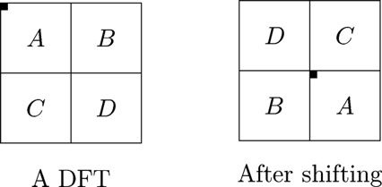
Two-Dimensional DFT: Shifting
Convenient to have DC coefficient center of matrix.
Happens if all elements f(x, y) in matrix are multiplied by (−1)x+y before the transform
Figure 7.8: Shifting a DFT

Slide 37
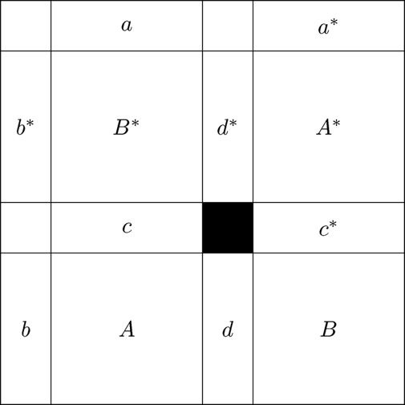
Two-Dimensional DFT: Conjugate Symmetry
half of the transform is a mirror image of the conjugate of the other half
Top mirrors bottom
Right mirrors left
Means ½ of transform is redundant information
Figure 7.9: Conjugate symmetry in the DFT

Slide 38
Two-Dimensional DFT: Conjugate Symmetry
What does it look like?
Because complex numbers involved, can’t view directly
But we can view their magnitude |F(u, v)|.
Numbers of type double
large range
need to scale these absolute values so that they can be displayed
Spectrum: display of the magnitude of a Fourier Transform

Slide 39
Experimenting with Fourier Transforms
Relevant functions
fft, takes the DFT of a vector
ifft, takes the inverse DFT of a vector
fft2, takes the DFT of a matrix
ifft2, takes the inverse DFT of a matrix
fftshift, shifts a transform

Slide 40

Fourier Transforms of Synthetic Images
Example 2
Figure 7.10: A single edge and its DFT

Slide 41

Fourier Transforms of Synthetic Images
Example 2
Figure 7.11: A box and its DFT

Slide 42

Fourier Transforms of Synthetic Images
Example 2
Note that the transform of the rotated box is the rotated transform of the original box.
Figure 7.12: A rotated box and its DFT

Slide 43
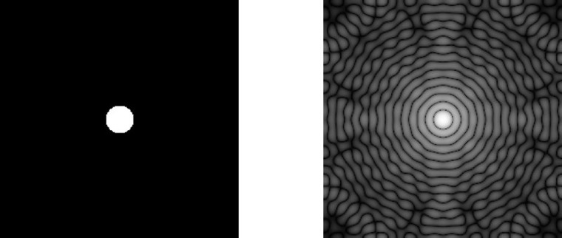
Fourier Transforms of Synthetic Images
Example 2
Figure 7.13: A circle and its DFT

Slide 44
Fourier Transforms of Synthetic Images
An edge appears in the transform as a line of values at right angles to the edge
We may consider the values on the line as being the coefficients of the appropriate corrugation functions which sum to the edge
With the circle, we have lines of values radiating out from the circle
these values appear as circles in the transform

Slide 45

Filtering in the Frequency Domain
Why Use FFT in image processing?
Convolution theorem: Spatial convolution can be performed by element-wise multiplication of the Fourier Transform by a suitable “filter matrix”

Slide 46
Low Pass Filtering
Definition:
Eliminate the outer values and keep the inner ones
Ideal low pass matrix
Binary matrix m defined by

Slide 47
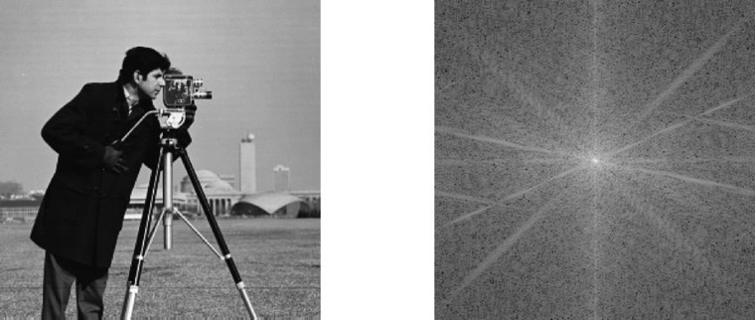
Low Pass Filtering
Figure 7.14: The “cameraman” image and its DFT

Slide 48
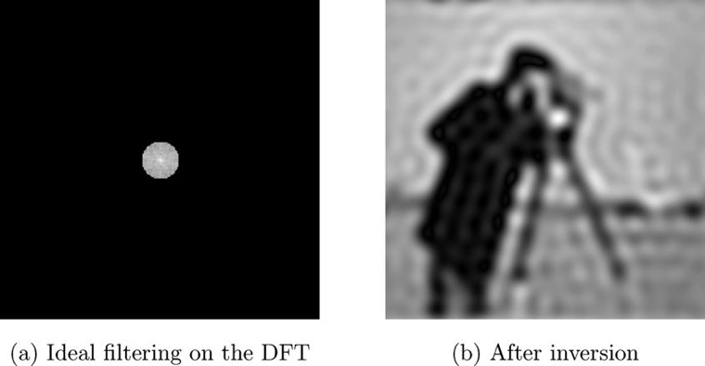
Low Pass Filtering
Figure 7.15: Applying ideal low pass filtering

Slide 49
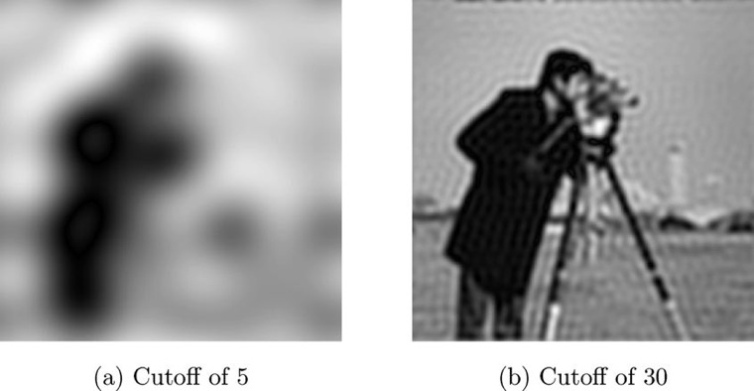
Low Pass Filtering
Expect:
Smaller the circle, the more blurred the image
Larger the circle, the less blurred
Figure 7.16: Ideal low pass filtering with different cutoffs

Slide 50
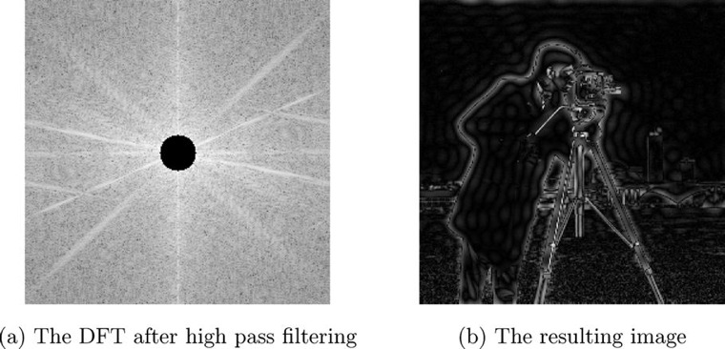
High Pass Filtering
Definition:
Eliminating center values and keeping the others
Figure 7.17: Applying an ideal high pass filter to an image

Slide 51
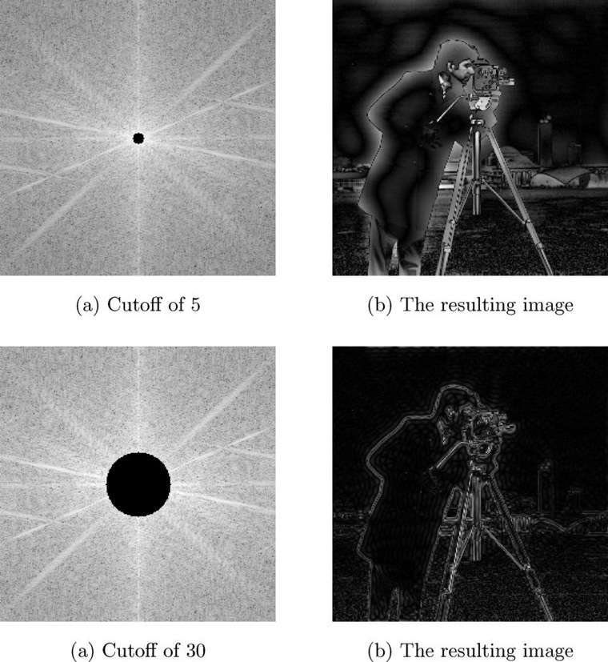
High Pass Filtering
Figure 7.18: Ideal high pass filtering with different cutoffs

Slide 52


Butterworth Filtering
Butterworth filter functions are based on the following functions:
Low pass filters:
High pass filters:
Where in each case the parameter n is called the order of the filter

Slide 53
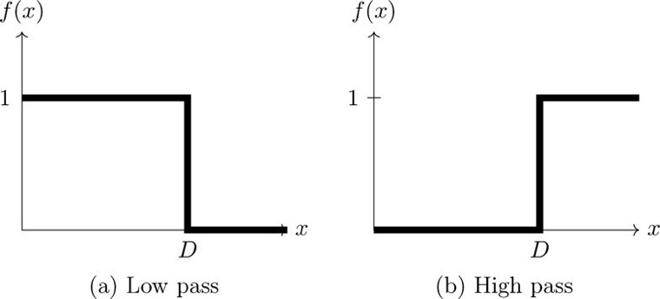
Butterworth Filtering
Figure 7.19: Ideal filter functions

Slide 54
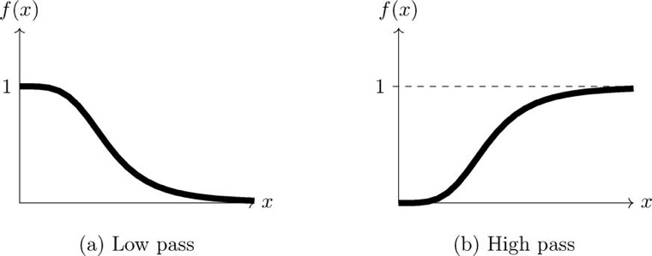
Butterworth Filtering
Figure 7.20: Butterworth filter functions with n = 2

Slide 55
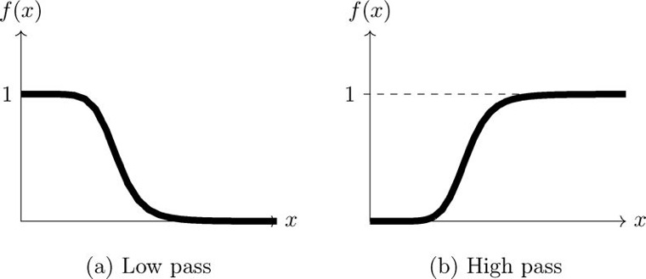
Butterworth Filtering
Figure 7.21: Butterworth filter functions with n = 4

Slide 56
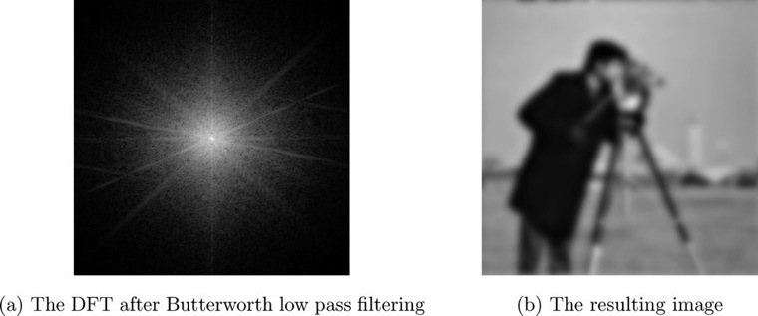
Butterworth Filtering
Figure 7.22: Butterworth low pass filtering

Slide 57
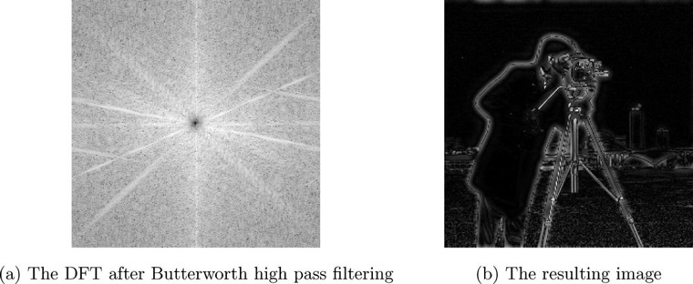
Butterworth Filtering
Figure 7.23: Butterworth high pass filtering

Slide 58
Gaussian Filtering
Implementation
Create Guassian filter
Multiply it by the image transform
Invert the result
Considered the most “smooth”

Slide 59
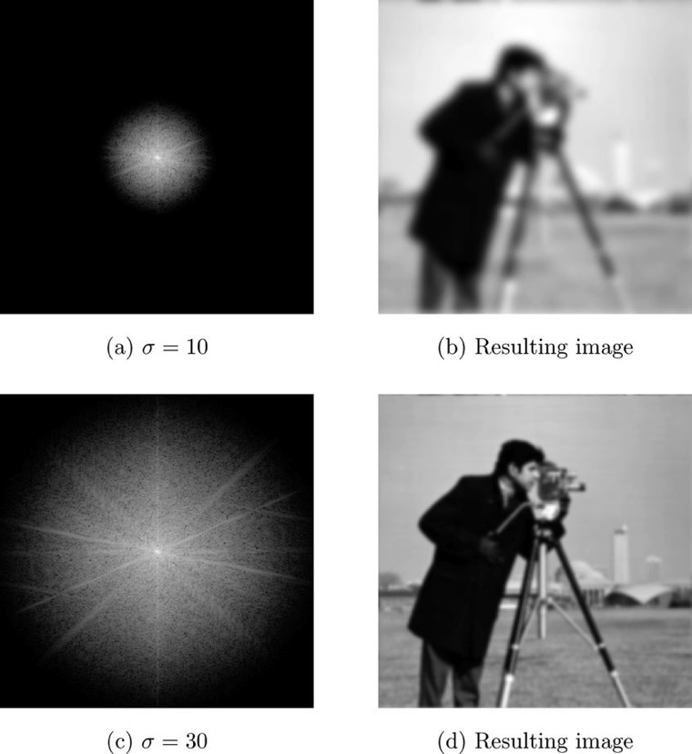
Gaussian Filtering
Figure 7.24: Applying a Gaussian low pass filter in the frequency domain

Slide 60
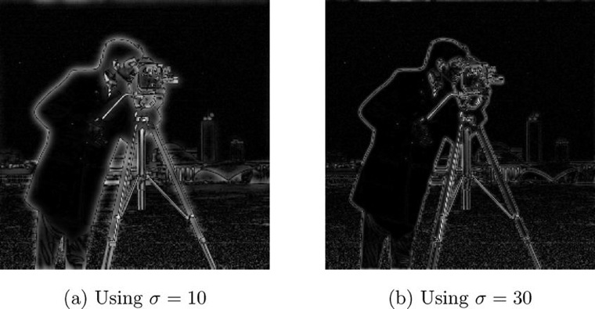
Gaussian Filtering
Figure 7.25: Applying a Gaussian high pass filter in the frequency domain

